Slide 1


Project 1: Development demonstration
ROSHAN DHITAL (30361962)
PRODUCT OWNER: Kamal Pun (30371365)
SCRUM MASTER: Riaz Qadir (30364968)
DESIGNER : Haque Mohammad (30379834)
PROGRAMMER: Singh Jashandeep (30362218)

Slide 2
Introduction:
The ongoing project development process of mobile application is to be created on behalf of scanning barcode holding meetings, designing prototypes and choosing appropriate tools and techniques. In this project, the project team strides to focus on:
Scanning barcode or manually entering information.
Retrieving information from data centre.
Simplicity of use with user friendly tools and techniques.
Modifiable/updatable nature of an application.
Flexibility to any of the OS.
Improvement of efficiency of a service offered by users.
.
1.
2.
3.

Slide 3
Client and supervisor description: The client, Rifat Sharmin, is managing the Babatye clothing store and has taken a great role for completion of project requirements and this project is done under the supervision of Mr. Sunil Cooray offering feeds to our deeds.
Team works:
Connecting to develop a project via a social media.
Holding meetings with the client and supervisor on a regular basis.
Breaking down the tasks to work on individual parts.
Gathering resources to obtain information for better outcome.

Slide 4
Roles and Responsibilities:
Stake holders | Represent | Roles
Roshan Dhital | Project Leader | Roshan is The project Leader of our team where he will be looking after the team and work and where needed he will be guiding us as project leader has got major responsibility of the team.
Kamal Pun | Product Owner | Product owner is the one who will be prioritising the necessary work and has a responsibility for managing the requirements. It is the duty of product owner to finalise the work.
Riaz Qadir | Scrum Master | Riaz will be looking after the communications with client and supervisor as a scrum master it is his role to keep track of every change is documented and process is followed properly
Jasshandeep Singh | Programmer | Jass is the team member who will be looking after the coding and programing of the app.
Muhammad Haque | Designer | Muhammad will be assisting kamal in overall reports and will be designing the basics of the app.

Slide 5
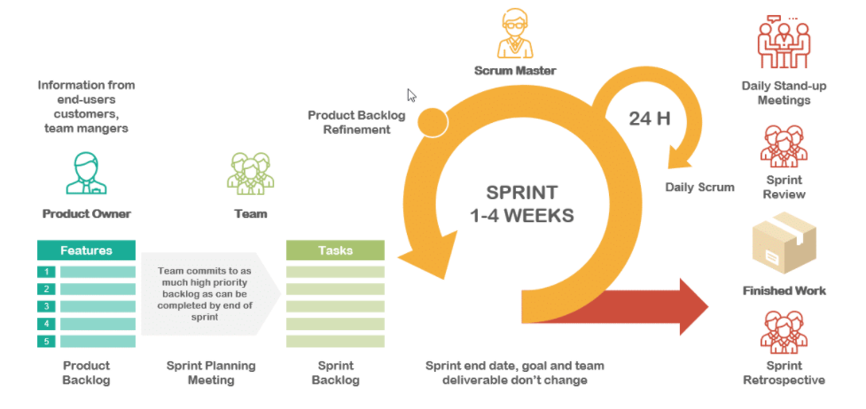
Scrum framework

Slide 6
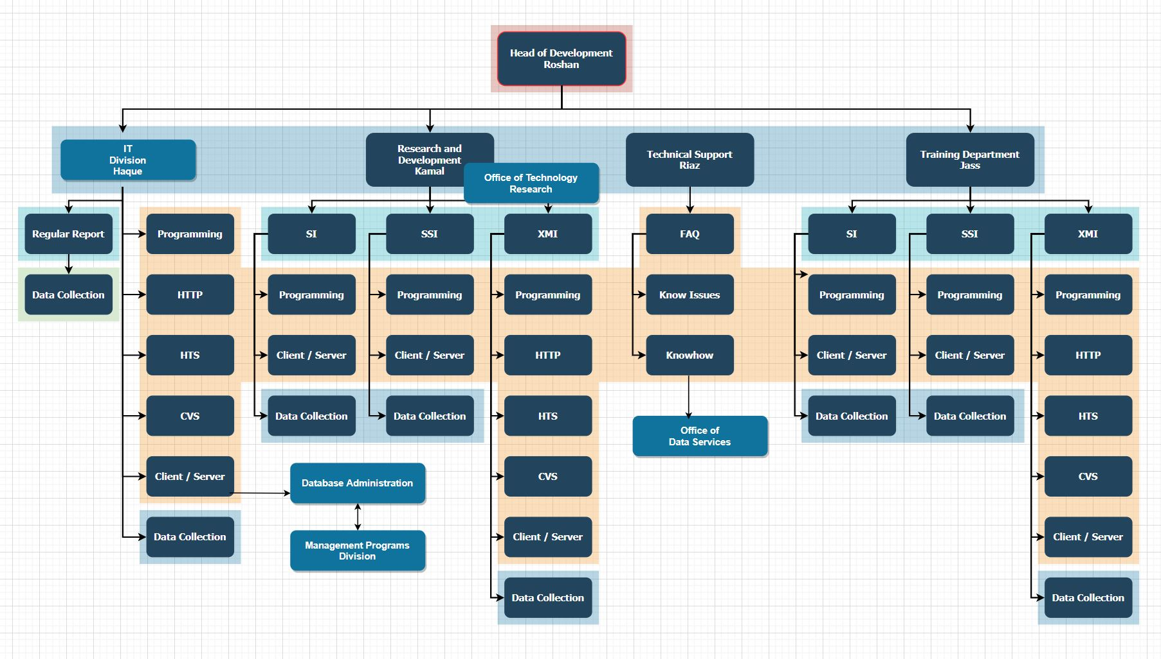

Slide 7
Communication tools
Contact with the group member | Contact with the client | Contact with tutor | Contact with supervisor
What’s app |  |  | What’s app
Mobile phone |  | Email | Adobe connect
 | Zoom | Adobe connect
 | Email

Slide 8
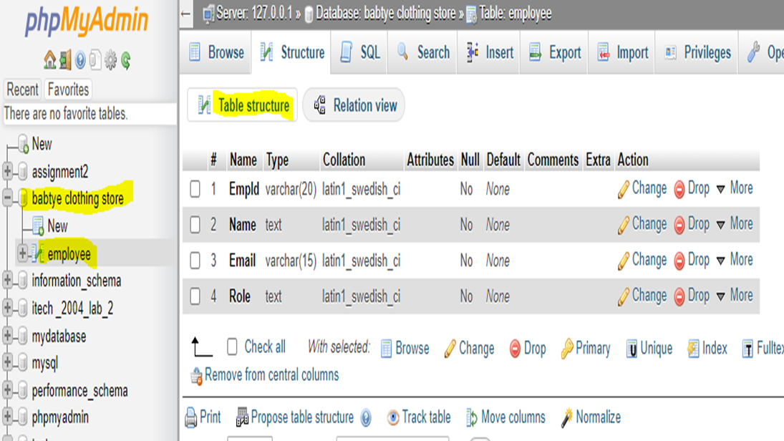

Slide 9
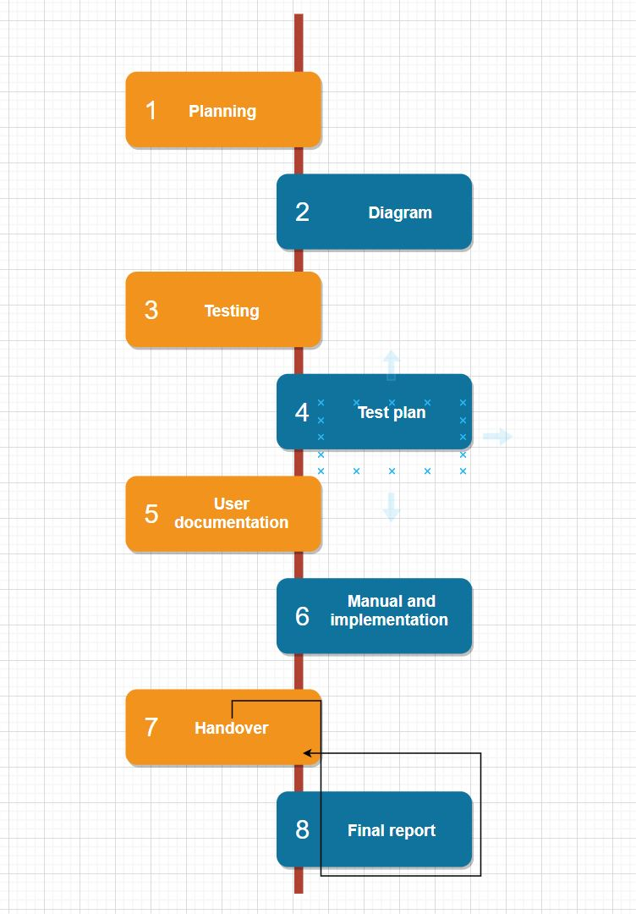
Technical process
Planning: we know the purpose and scope of the project. This may seem obvious but spending time up front can reduce the actual writing time as well as head off costly, significant changes during the project. We did make sure to identify goals, existing resources (internal, contract or outsourcing), style guides, deadlines, costs, and final deliverables.

Slide 10
Requirement | Condition of Satisfaction | Tasks & Estimates
US1 As a user, I want to create an account so that I can start using scanner app. | Account creation page on login page. Clicking that link user should be directed to registration form. After putting credentials, the form should send an email to the respective user’s email for verification purpose. After verification, the user should be able to login with those credentials. | T1 The login page of the app should let the user to enter their credentials like name and email – ½ day (Riaz) T2 User should be notified if the credentials are incorrect – ½ day (Riaz) T3 The registration form should let user to submit it through mobile app and send verification email – ½ day (Riaz) T4 Create page to show successful creation of user login – ½ day Mohammad T5 User information is stored in data repository – 1 day (Kamal & Jashandeep)
US2 As a user, I want to login so that I can start using app to scan barcode of cloths to save time. | The user should be able to login successfully. The user should be able see mobile app interface. The app should scan barcode of cloths. | T6 The interface of mobile app should be shown after successful login – 1 day (Roshan) T7 The app should be able to scan barcodes – 1 day (Roshan & Mohammad) T8 Information retrieved from barcode is shown in interface – 1 day (Jashandeep) T9 Design activity diagram of the account creation process – 1 day (Kamal)

Slide 11
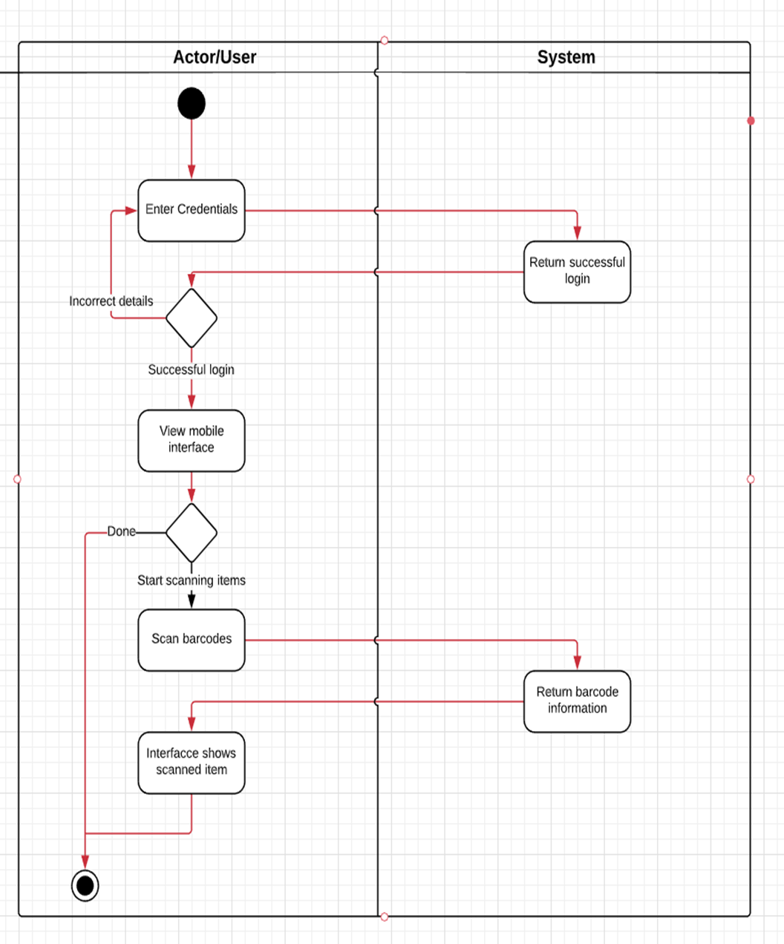
Activity Diagram

Slide 12
DEMONSTRATION OF DEVELOPMENT PROGRESS
THEME
Our main aim for this project to improve inventory management as present barcode scanners does not allow real time data editing methods such as info about restocking , lot numbers etc to improve inventory control
REVIEW MEETINGS
all of our review meetings with our client went well
all the team members work accordingly the discussions and suggestions given on work in the meeting.
Feedback was given on each of the team members’s work on weekly basis

Slide 13
MAJOR TASK ACCOMPLISHED after grooming meetings
ACCESSABILITY
our app infrastructure is designed in a such a way that its functionalities can be used efficiently and conveniently
CHANGE IN APP INTERFACES
As in our 2nd meeting with our client , our main focus was to make app less time consuming thus , we removed sort of complex activities such as Login FORMs for users
OFFLINE USE of DATABASE
For improving ux , sometimes , cameras of the users are not able to scan barcodes due to their compatabilities, thus, we pop up with the idea of manually entering barcode number on the database at that stage
Thus ,later on , information regarding specific product can be retrieved and business standards can be maintained

Slide 14
Progress
Task | Progress
Project Vision | Completed
Product Backlog | Completed
Project Plan | Completed
Sprint 1 | Completed
Development Demonstration 1 | In progress
Sprint 2 | In progress
Development Demonstration 2 | In progress
Prototype | In progress
Progress

Slide 15
Item 1: What went well?
The demonstration of tasks went well.
Each of the team members participated on the zoom meeting with the client and were engaging.
Project work was divided equally among the team members and essential resources were accumulated to come up with the best solution.
Team members had the clear understanding of a project and how it could be achieved.
Improved backlog requirements.

Slide 16
Item 2: What could be improved?
User interface could be improved.
Monitoring of actual tasks should be done regularly.
Each of the members in a group could not attend the call or respond to the text message in some cases because of their busy schedule thus, meeting could have been done several times in a week by mentioning exact date and time.
We should have broadened our knowledge regarding app development and its convenience to the client and our daily tasks should be controlled and monitored.
Each task should be finished on estimated time.

Slide 17
Item 3: What can we do?
Email drafts frequently to client and supervisor to get feedbacks.
As stand up meeting, we are doing on regular basis as well as before our meeting with clients and supervisors, we can increase the time for being more focused on questionaries.
Give personal feedback and points of views on each of the team members by one another.
Item 4: What is not in our control?
Getting feedback from client and supervisor prior to deadlines as we started our first meeting late.
Connection problem.

Slide 18
END OF THE PRESENTATION
THANK YOU
PLEASE ASK IF YOU HAVE ANY QUESTION

